Slide 1


INTERNSHIP ON
MOBILE APP DEVELOPMENT
Done by: R. Niranjanadevi Register Number: 23IFTE031
Guide: Dr. Sudhasini P, M.S(IT)., M.B.A., M.Phil., Ph.D., Assistant Professor Organization Mentor: Mr. Rajeshwaran,
Dot Com Infoway, Madurai

Slide 2

CONTENT
About Company Work Done Reflexion Output

Slide 3

ABOUT COMPANY
Company Name: Dot Com Infoway (DCI)
Location: I Floor, Vaigai Colony, Plot No. 3, 80 Feet Rd, opp. to Ambika Theatre, Anna Nagar, Madurai, Tamil Nadu 625020
Overview:
A premier IT company offering offshore outsourcing solutions globally
Provides end-to-end IT services: software, web, mobile apps, and digital marketing Known for scalable, customized, and cost-effective enterprise solutions
Strengths:
Uses Global Delivery Model and strong QA processes
Focused on streamlining business operations and boosting productivity
Delivers reliable solutions on-time and within budget

Slide 4


WORK DONE
Frontend Development:
Built a modern, cross-platform React Native UI with TypeScript and Expo SDK.
Designed a responsive travel guide interface with smooth navigation using Expo Router and React Navigation.
Implemented Google Maps integration, a carousel for featured destinations, and dynamic UI components ( Lucide Icons, gradients, animations via Moti/Reanimated).
Focused on premium UI/UX with lazy loading and a clean visual hierarchy.

Slide 5
Backend:
Used static JSON data and local storage ( AsyncStorage ) to simulate backend and booking flows.
Incorporated mock APIs for destination details and booking validation.
No live backend was used — designed as an offline-first prototype.
Tools Used:
Visual Studio Code (VS Code) – coding, linting, and debugging.
Expo Go – real-time preview and live testing on mobile devices.
ESLint + Prettier – to maintain code quality and formatting.

Slide 6
Commands Used
To create a new, React Native project:
bash
npx create-expo-app travel-guide
To run and view the project output with tunnel support:
bash
npx expo start --tunnel

Slide 7



REFLECTIONS
Developed a real-world cross-platform travel guide app using React Native, TypeScript, and Expo.
Built modular and reusable components (cards, carousels, booking forms) for a scalable UI.
Integrated Google Maps API and dynamic navigation flows with React Navigation & Expo Router.
Designed a clean, performance-first app structure with optimized state management via Context API and AsyncStorage.
Implemented offline-first features like caching, persistent favorites, and local data storage.
Strengthened problem-solving & debugging skills by handling API errors, navigation bugs, and asynchronous flows.
Enhanced UI/UX skills with smooth animations using Reanimated, Linear Gradient, and Moti.
Practiced agile-style development — planning, iterating, and refining app modules.
Tested and previewed apps on multiple devices using Expo Go for cross-platform consistency.
Improved professional coding habits — version control with Git/GitHub, linting with ESLint, and code formatting with Prettier.
Gained experience in documentation and presentation (README, architecture diagrams, and feature roadmaps).

Slide 8

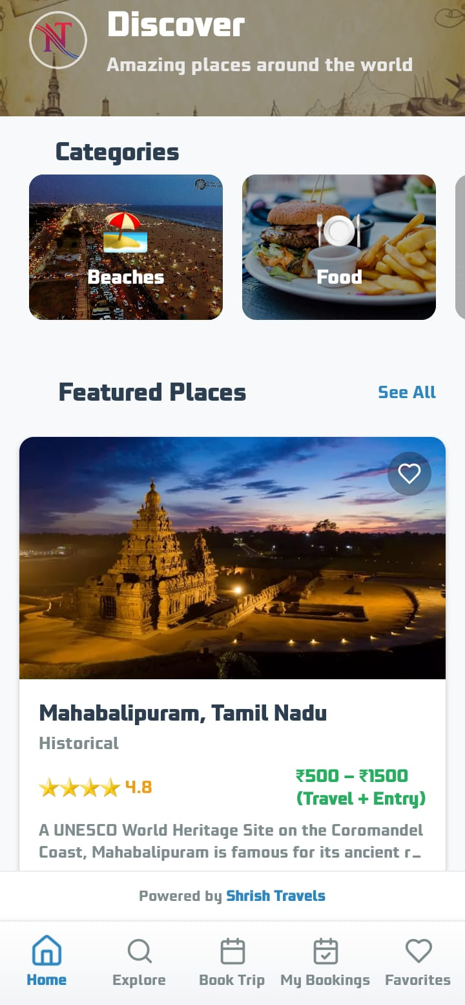
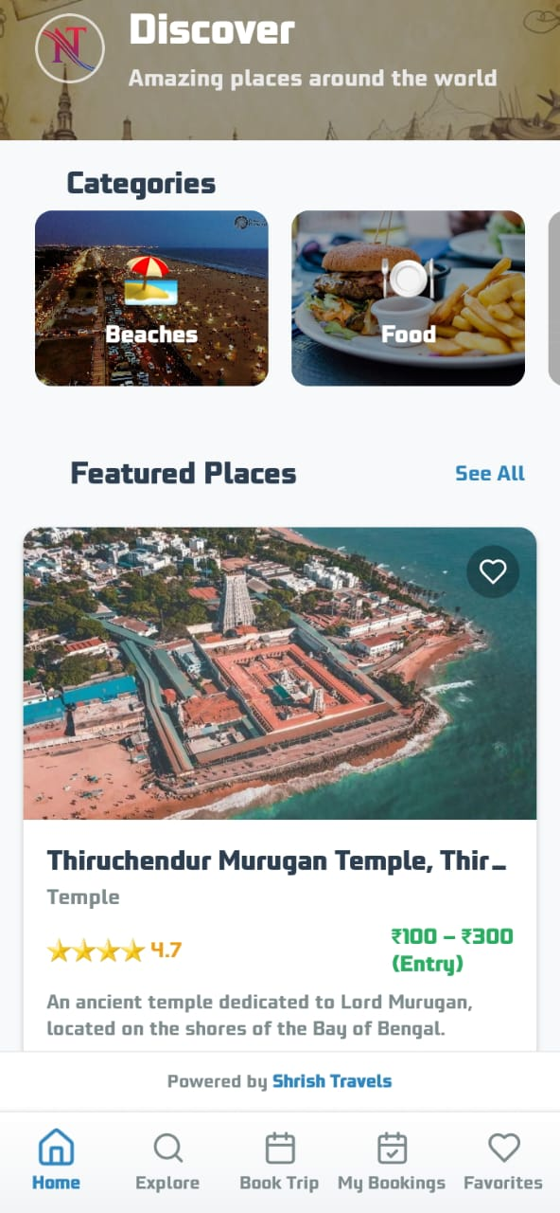
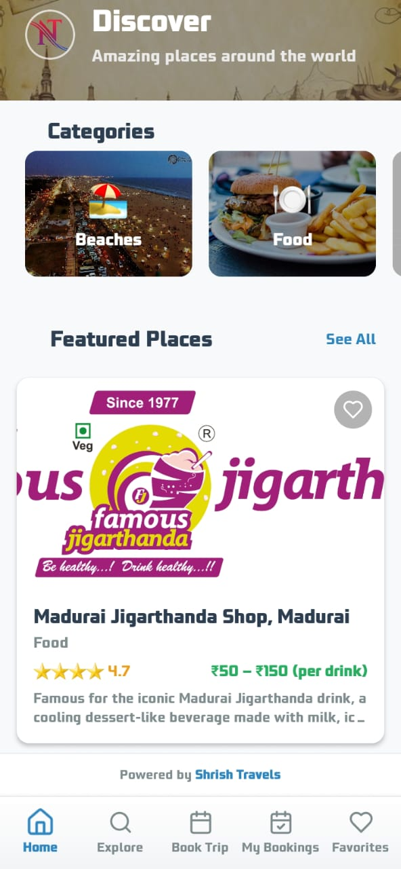

OUTPUT
Home Page: Displays a dynamically updating ‘Featured Places’ carousel.

Slide 9


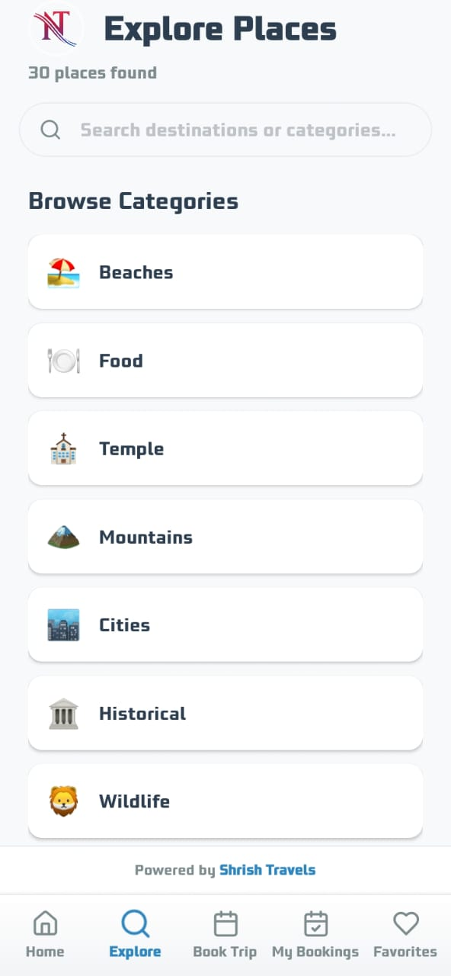
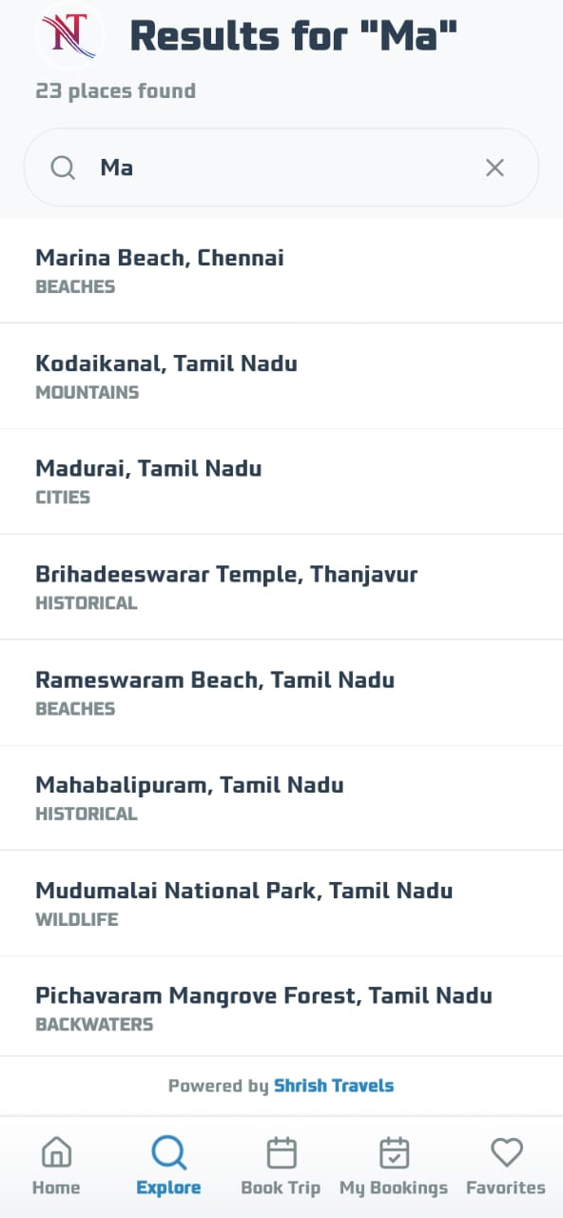
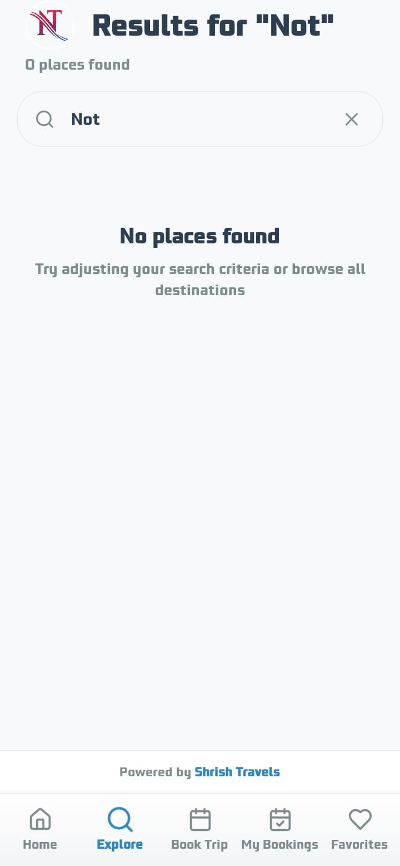

Explore Page: Offers category-based browsing (Beaches, Food, Temples, etc.) and real-time search with instant results and clear feedback when no matches are found.

Slide 10


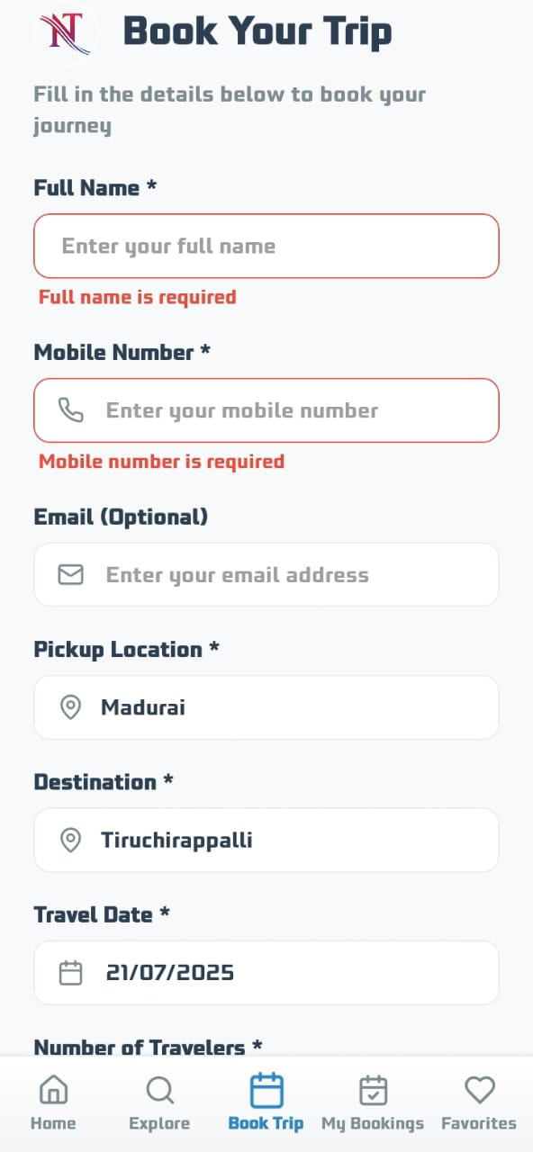
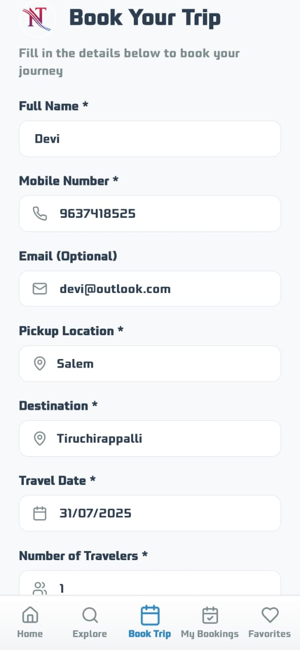
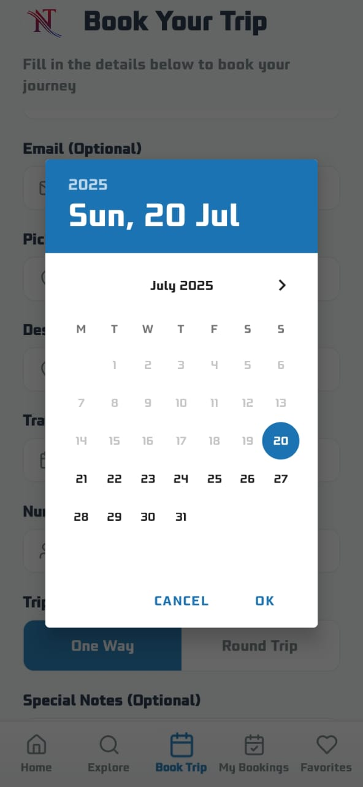
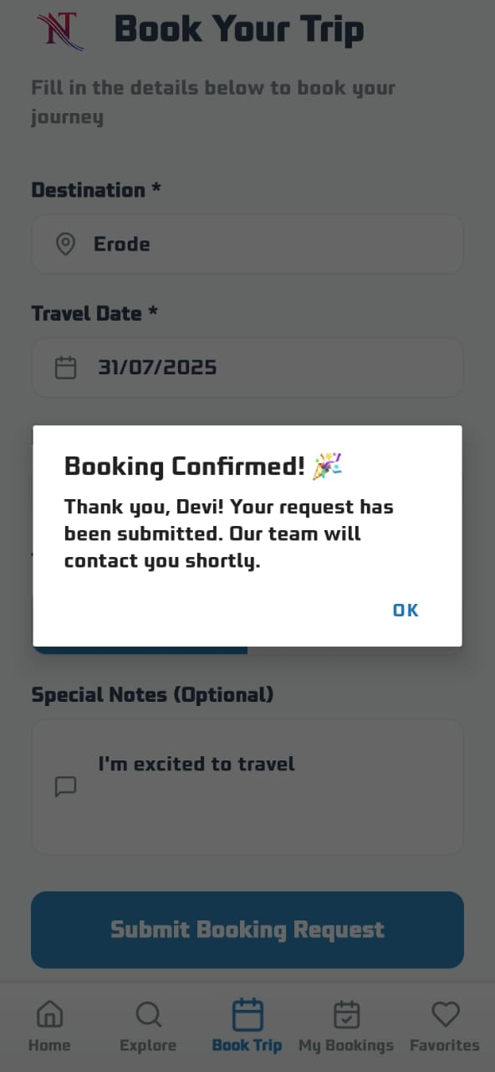
Booking Interface: Multi-step form with real-time validation, calendar integration, and confirmation feedback for seamless trip planning.

Slide 11


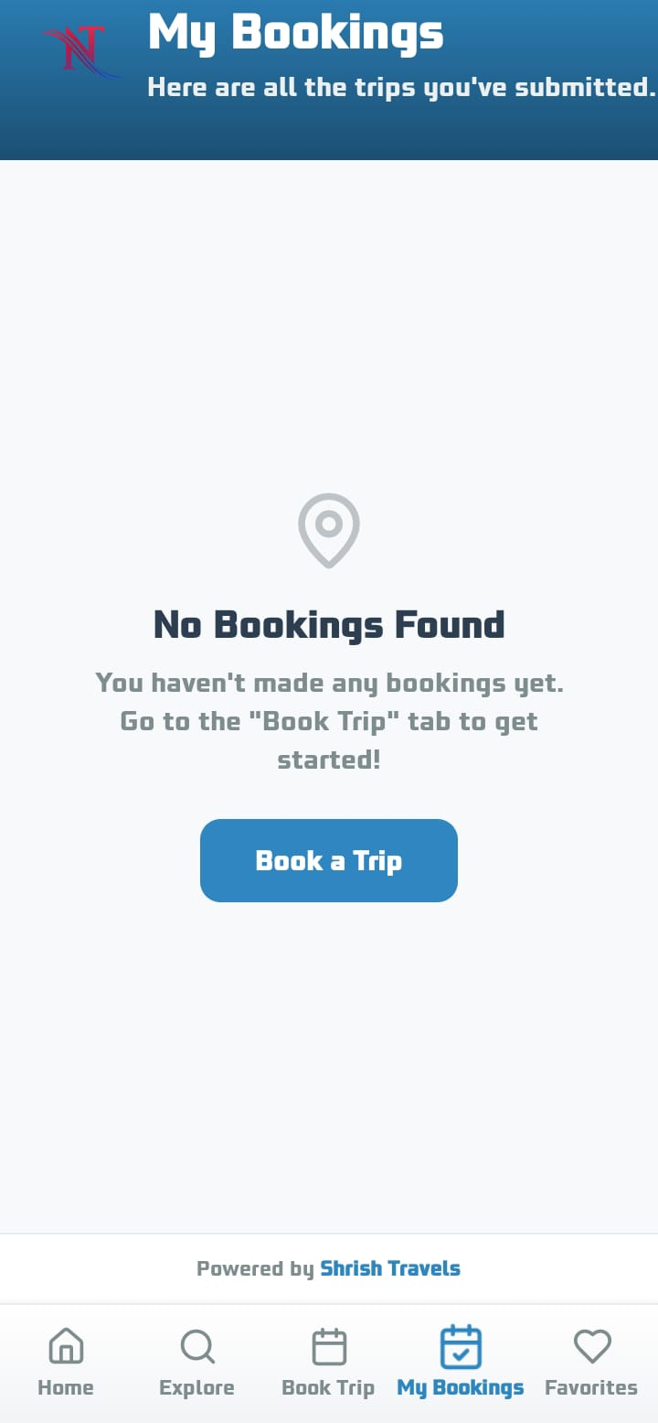
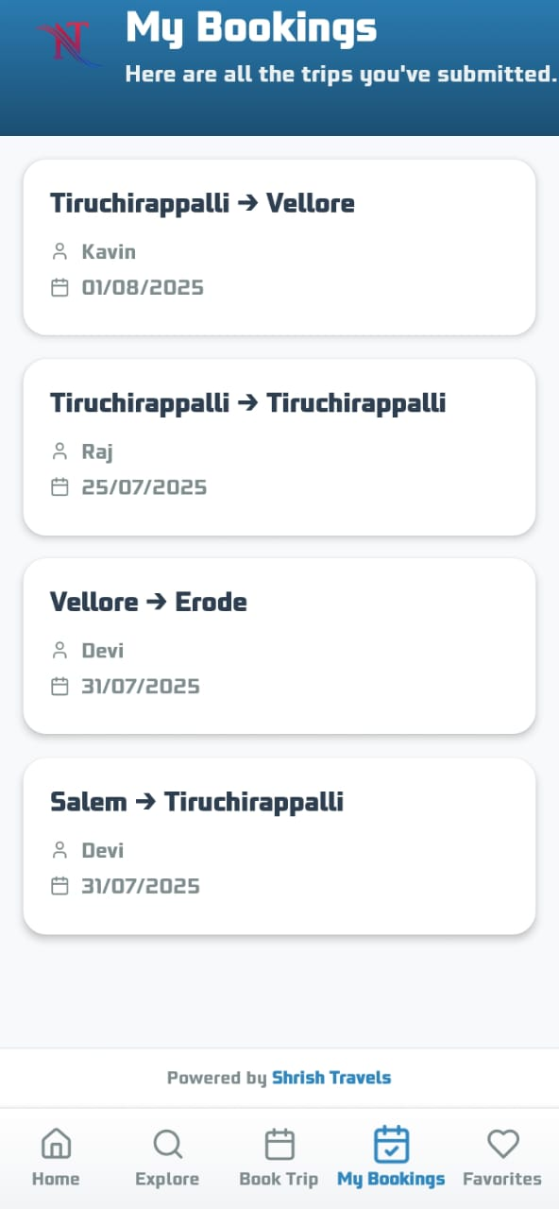
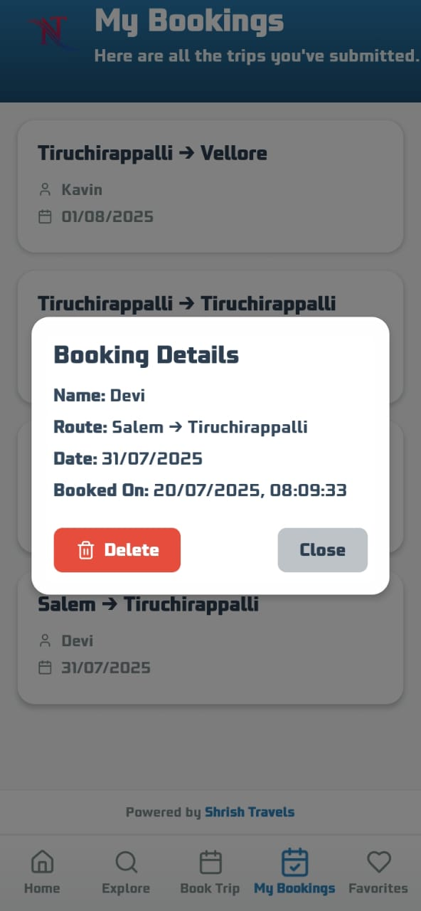

My Bookings: Displays trip history with details and a call-to-action for new bookings.

Slide 12


CONCLUSION
The development of the Travel Guide App — Tamil Nadu Tourism was a highly valuable hands-on experience.
It allowed me to apply React Native, TypeScript, and Expo SDK in building a real-world, cross-platform mobile application.
I improved my skills in UI/UX design, state management (React Context), and integrating Google Maps APIs, while following modern mobile development workflows.
I learned how to structure a scalable app architecture, optimize performance, and implement persistent storage using AsyncStorage.
This project strengthened my ability to work independently, manage milestones, and deliver a polished solution — preparing me for future roles in mobile and full-stack development.

Slide 13

ACKNOWLEDGEMENT
At the outset, I sincerely thank the Almighty for His blessings in helping me successfully complete my internship.
I extend my heartfelt gratitude to our Principal and Secretary, Dr. Beulah Jeyashree R., M.A., M.Phil., Ph.D., for her continuous support and encouragement.
I am deeply thankful to Dr. N. Jayachandra, M.Sc., M.Phil., Ph.D., Head & Associate Professor, Department of Computer Science, for her valuable guidance throughout the internship.
I also thank Dr. T. R. Sivapriya, M.C.A., M.Phil., Ph.D., Coordinator for B.Sc. Information Technology & Associate Professor, Department of Computer Science, for her continued support.
My sincere thanks to the management and team of Dot Com Infoway (DCI) for providing a positive and enriching learning experience.
I express my gratitude to my internship mentor, Dr. Sudhasini P., M.S. (IT), M.B.A., M.Phil., Ph.D.,Assistant Professor, Department of Computer Science, for her constructive guidance.
Finally, I thank all the faculty members of the Department of Computer Science, my parents, and friends for their constant motivation and support.

Slide 14
Thanks for listening

